Slide 1
Analyzing Smartphone-Based Recognition Data of Human Activities and Postural Transitions
Rujia Yuan
Supervised by Dr. Jadhav

Slide 2
1. Research Question
2. Smartphone-Based Recognition of Human Activities and Postural Transitions Data Set
3. Previous Study Approaches
4. Analysis Method Background
5. My Data Analysis

Slide 3




Human Activity Recognition (HAR)
HAR aims to provide information on human physical activity and to detect simple or complex actions in a real-world setting.
In HAR, various human activities such as walking, running, playing soccer, walking upstairs, etc. are recognized.
HAR provides personalized support for many different fields of study such as medicine, human-computer interaction, sociology..
HAR, specifically, can offer accurate feedbacks about people’s health status, and therefore it could help evaluate citizens’ overall healthy conditions.

Slide 4
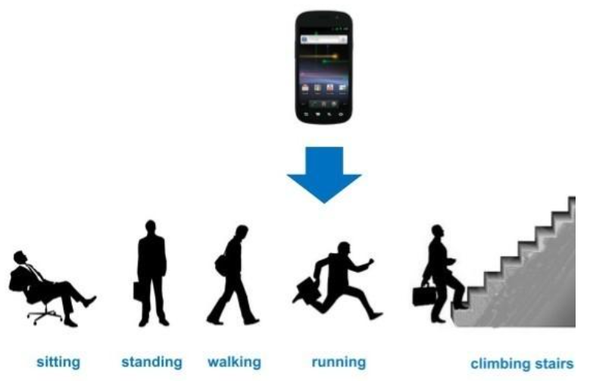
Predictions of
Human Activities and Postural Transitions based on Accelerometer and Gyroscope of
the Smartphone Devices
Notes:
Human activity recognition can offer accurate feedbacks about people’s health status, and therefore it could help evaluate citizens’ overall healthy conditions. As a topic with increasing heat, it has gradually become mature for use and has been adopted by more and more scholars. Human activity recognition could be a challenge to be recorded, since it is abstract and hard to be analyzed. However, researchers could monitor one’s activity patterns, based on the collectable data such as accelerator and gyroscope of the smartphone devices taken by the needed person.

Slide 5
Dataset Background
A group of 30 volunteers with the ages between 19 and 48
6 main activities +6 postural transitions: 1. Walking, 2. Walking upstairs, 3. Walking downstairs, 4. Sitting, 5. Standing, 6. Laying, 7. Stand to sit, 8. Sit to stand, 9. Sit to lie, 10. Lie to sit, 11. Stand to lie, 12. Lie to stand.
10929 instances, with 7767(70%) as training data and 3162(30%) as testing data
3-axial linear acceleration and angular velocity signals were captured using the phone accelerometer and gyroscope at a sampling rate of 50Hz.
The acceleration signal was separated then into body acceleration and gravity.
561 different features

Slide 6
Features examples
tBodyAcc: body acceleration signals
tBodyAcc-Mean-1
tGravityAccMag-Max-1
Mean: estimated by mean value
1: x-axial
tGravityAcc: gravity acceleration signals
Mag: the magnitude
Max: estimated by maximum value
1: x-axial

Slide 7
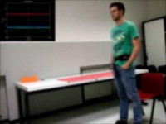

Slide 8
Previous Study Approaches
In the article A Public Domain Dataset for Human Activity Recognition Using Smartphones, Davide Anguita, Alessandro Ghio, Luca Oneto, Xavier Parra and Jorge L. Reyes-Ortiz worked together to present a new dataset that has been created using inertial data from smartphone accelerometers and gyroscopes to target the recognition of six different human activities.
They utilized a multi class Support Vector Machine (SVM) classifier on this dataset and got convincing results to show the use of smartphones, in addition to be more unobtrusive and less invasive than other special purpose solutions like wearable sensors, is a feasible way to work for effectively performing HAR.

Slide 9
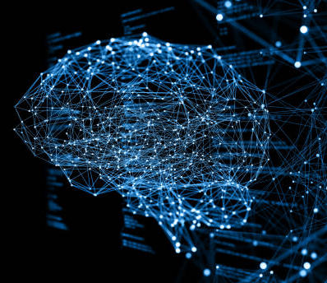
Analysis Method Background
Neural Network
Pros:
Learn and model the complicated nonlinear relationships between the inputs and outputs .
Reveal hidden relationships, patterns, and predictions behind the model.
Learn and improve continuously.
Cons:
Need a huge amount of data and the large cost of computations.
Notes:
Neural networks are a form of machine learning in which a computer learns to carry out a piece of work by being trained on examples

Slide 10
Neural Network
Layerss
Core
Elements
Of
Neural
Networks
Models
Loss functions
Optimizers

Slide 11
Neural Network
Layerss
fundamental data structure
Neural Network Architecture
networks of layers
Models
Loss functions
minimize the loss in the trainings
determine how neural networks updated
Polishment
&
Perfection
Optimizers

Slide 12
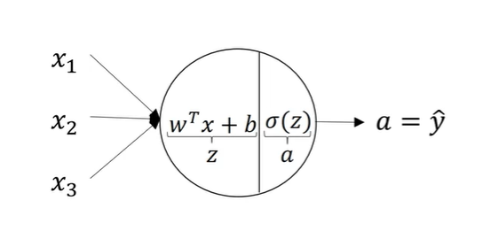
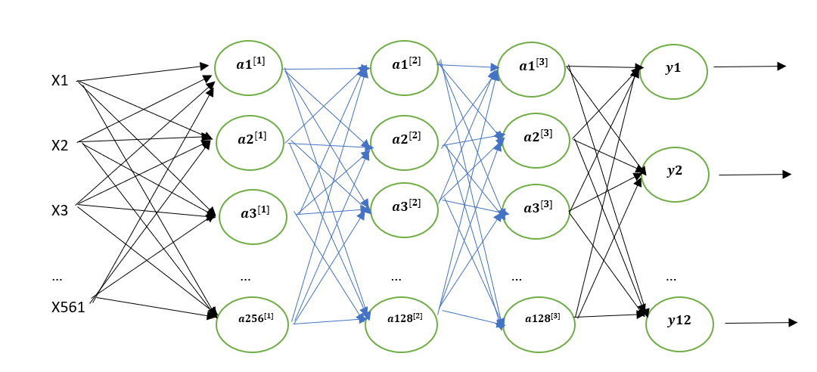
Input
Layers
Layerss
Hidden
Layers
Output
Layer
Notes:
W1 w2 w3 refers to weights, each weight signifies the strength of the connection between the two nodes. It decides the impact that the particular input needs in the summation function.

Slide 13
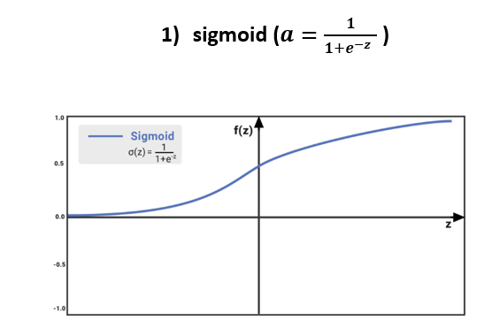
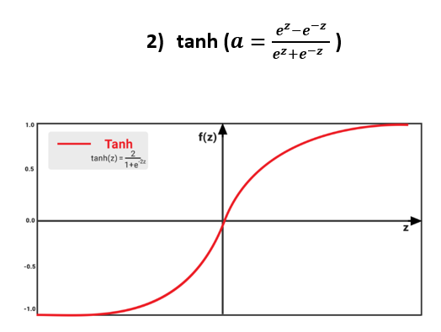
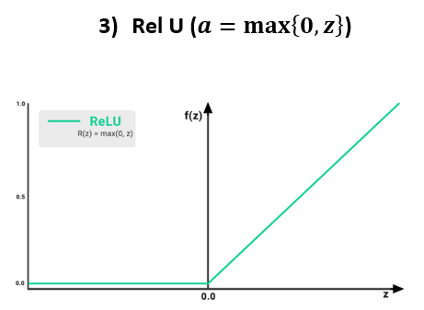
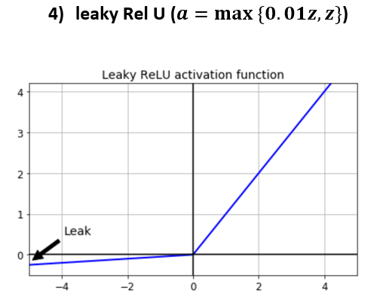
Activation Functions
We need to use activation functions both in the hidden layer and the output layer.
Directly related to how fast the neural network learns.
Notes:
using linear activation functions makes neural network learn faster – because there is less of effect of the slope function going to zero, which slows down learning

Slide 14

Loss Function
A method of evaluating how badly the algorithm models the dataset.
A method of giving the difference between actual values and predicted values.
The better the prediction is, the lower number the loss function will output.
Four major categories of loss functions: regressive loss functions, classification loss functions, embedding loss functions, and visualizing loss functions.
Categorical_crossentropy

Slide 15
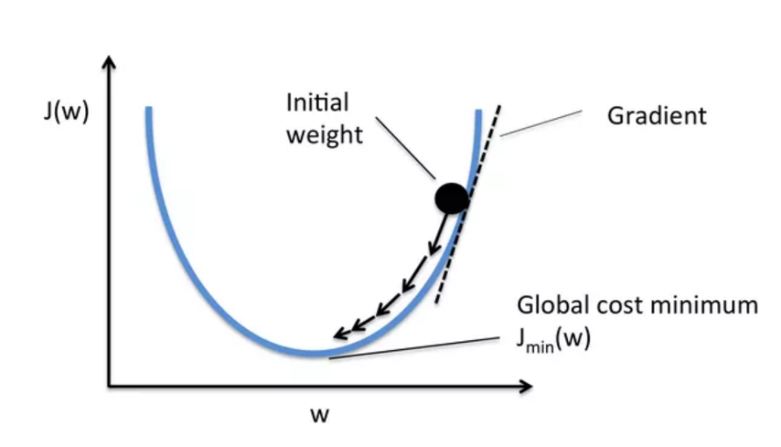
Optimization
To minimize the calculated error and modify the weights.
One most common used -- Gradient descent:
Calculate gradient for the whole dataset and updates values in direction opposite to the gradients until we find a local minima.

Slide 16
Neural Network
Analysis
Methods
Multinomial Logistic Regression
Support Vector Machines

Slide 17
Neural Network Model
Data Cleaning: no null data
One-hot encoding to the response data (originally activity status 1-12)
3-hidden-layer neural network model
RelU as activation functions for three hidden layers
Softmax as activation function for output layer
Categorical_crossentropy as loss function
Notes:
if we use linear activation function, computing the linear function no matter how many layers we have; categorical_crossentrophy is used when we have two or more categorical variables

Slide 18
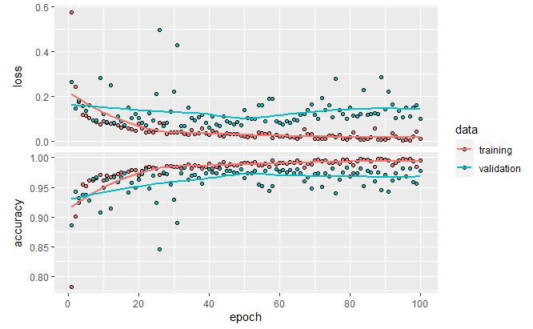

NN Results
Training
&
Validation
Testing
* MYMAIN

Slide 19
Multinominal Logistic Regression
Multinomial categorical regression model
Resulting accuracy: 0.8814042

Slide 20
Support Vector Machines
Multi-class support vector machines model
Resulting accuracy: 0.842821

Slide 21
Reference
Activation Functions in Neural Networks , Hamza Mahmood
Training Neural Networks for price prediction with TensorFlow, Jan Majewski
Loss Functions and Optimization Algorithms Demystified, Apoorva Agrawal
Neural Networks and Deep Learning, Andrew Ng
Deep Learning with R, Francois Chollet
Jorge-L. Reyes-Ortiz, Luca Oneto, Albert SamÃ , Xavier Parra, Davide Anguita. Transition-Aware Human Activity Recognition Using Smartphones.
A Public Domain Dataset for Human Activity Recognition Using Smartphones, Davide Anguita, Alessandro Ghio, Luca Oneto, Xavier Parra and Jorge L. Reyes-Ortiz
Golestani, N., Moghaddam, M. Human activity recognition using magnetic induction-based motion signals and deep recurrent neural networks
Flaticon Website (activity icons)

